Slide 1


Heart Failure Prediction Project
By Naira Hassan

Slide 2
Agenda
Business Understanding
Data Understanding
EDA Charts
Conclusion
Recommendations

Slide 3

Business Understanding:
Cardiovascular diseases (CVDs) are the number 1 cause of death globally, taking an estimated 17.9 million lives each year, which accounts for 31% of all deaths worldwide. Four out of 5CVD deaths are due to heart attacks and strokes, and one-third of these deaths occur prematurely in people under 70 years of age. Heart failure is a common event caused by CVDs and this dataset contains 11 features that can be used to predict a possible heart disease.
People with cardiovascular disease or who are at high cardiovascular risk need early detection and management where in a machine learning model can be of great help.
Objective: predict the possibility that the patient may have a heart failure due to some features.

Slide 4
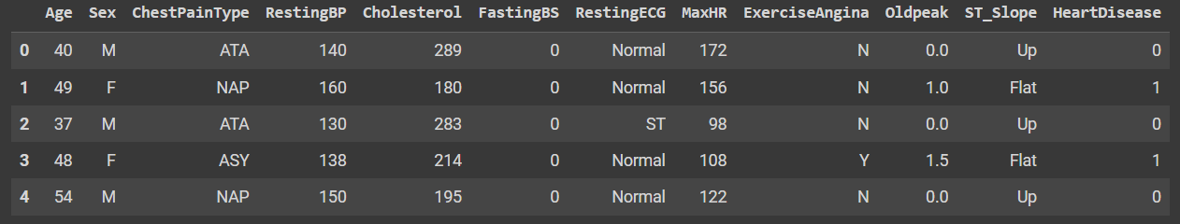
Data Understanding:
there are 918 rows & 12 columns.
11 features, and a column target that is HeartDisease.
There are no null values or duplicates.
but there are unexpected zeros values in RestingBP & Cholesterol columns.

Slide 5
Features
Age : a numerical feature referring to patient age per [years].
in the range 28 to 77.
Sex: a categorical feature referring to patient gender.
Binary values are M for males & F for females.
ChestPainType: a categorical feature referring to chest pain type.
TA: Typical Angina.
ATA: Atypical Angina.
NAP: Non-Anginal Pain.
ASY: Asymptomatic.
RestingBP: a numerical feature referring to resting blood pressure.
normal BP is 120/80 mm Hg.
these values refer to Systolic blood pressure which is 120.
Cholesterol: a numerical feature referring to serum cholesterol.
normal is less than 200 mm/dl.
200 to 240 above normal.
greater than 240 High.
FastingBS: a categorical feature referring to fasting blood sugar.
Binary values
1 if FastingBS > 120 mg/dl
0 otherwise
RestingECG: a categorical feature referring to resting electrocardiogram results
Normal: Normal
ST: having ST-T wave abnormality.
LVH: showing probable or definite left ventricular hypertrophy by Este's criteria.
MaxHR: a numerical feature referring to the maximum heart rate achieved.
A numeric value between 60 and 202
Normal Range 60:100
change max value based on age.
ExerciseAngina: a categorical feature referring to exercise-induced angina.
Binary values are
Y: Yes
N: No
Oldpeak: a numerical feature referring to old peak = ST.
Numeric value measured in depression.
ST depression induced by exercise relative to rest.
ST_Slope: a categorical feature referring to the slope of the peak exercise ST segment.
Up: upsloping: better heart rate with exercise.
Flat: flat sloping: minimal change (typical healthy heart).
Down: down sloping: signs of an unhealthy heart.

Slide 6
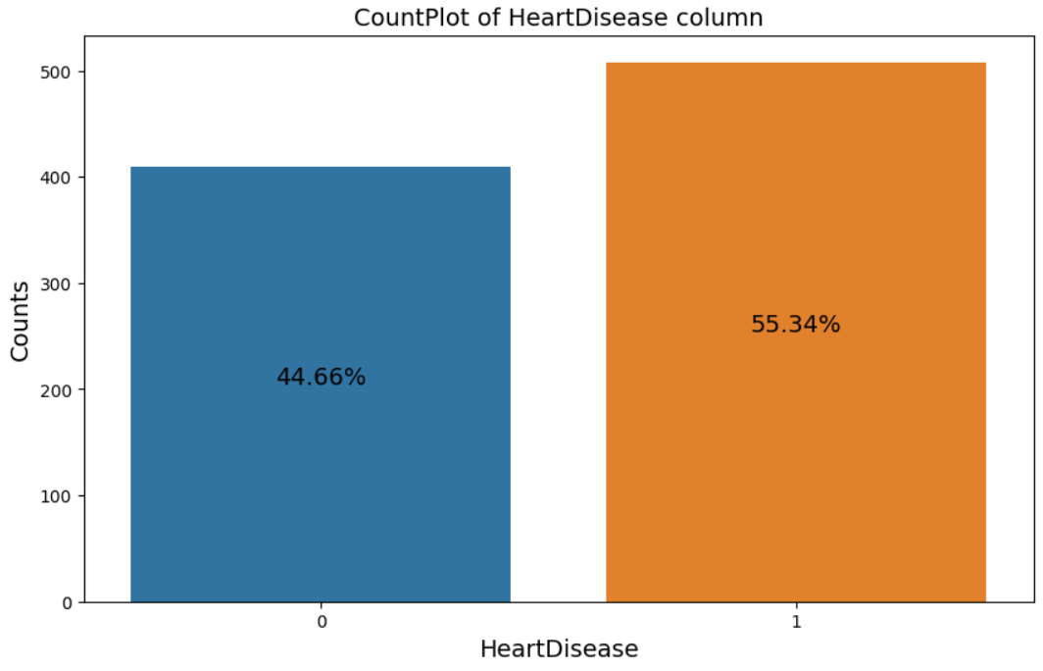
Label : Target
HeartDisease: a categorical feature referring to Heart Failure.
1: Heart disease
0: Normal

Slide 7
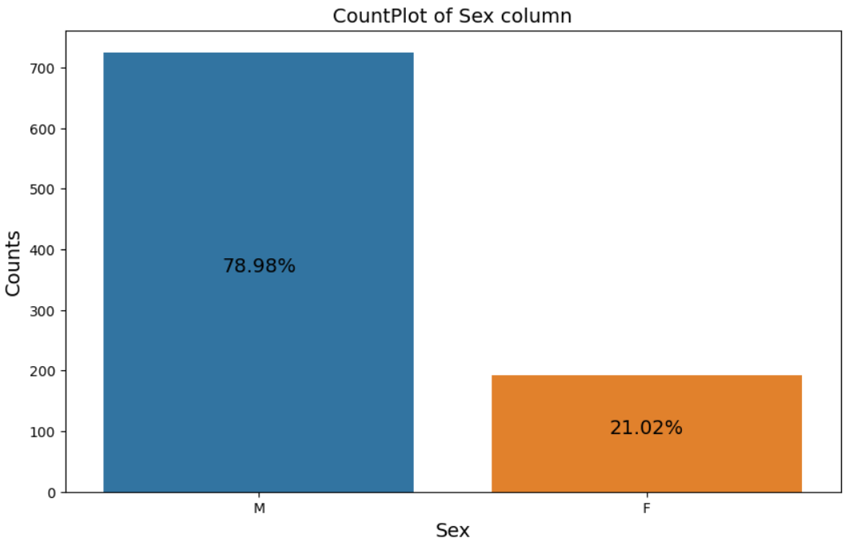
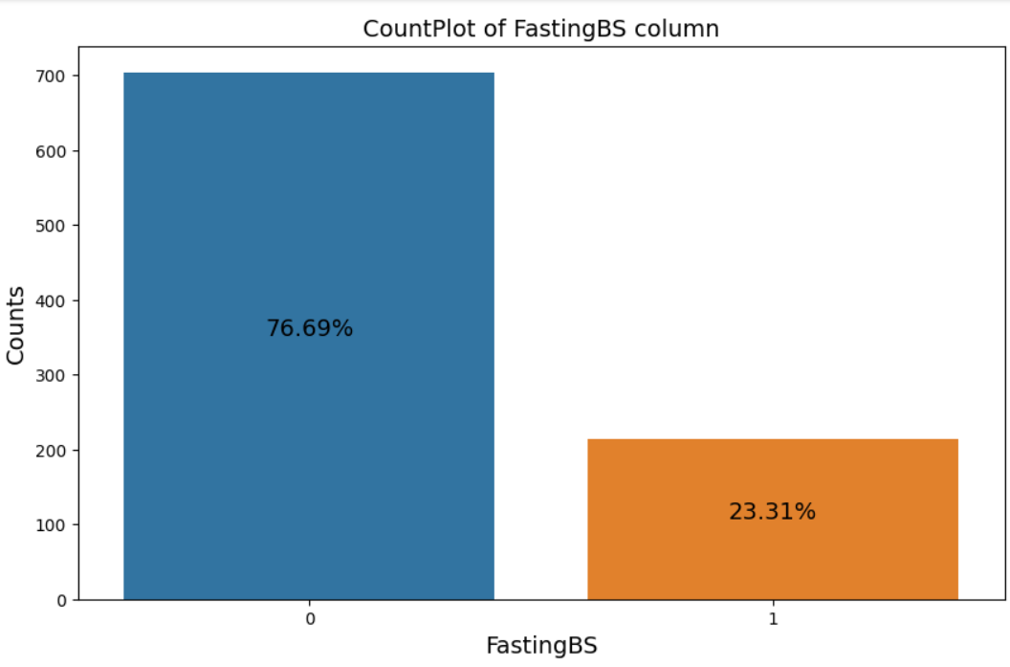
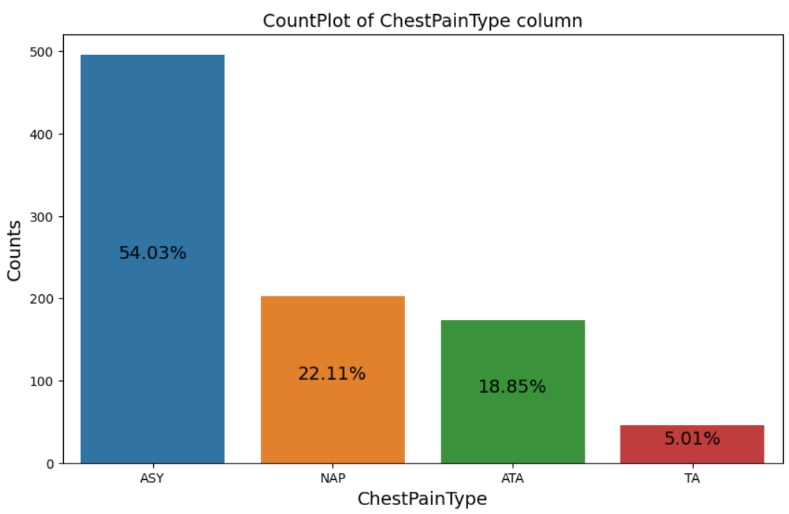
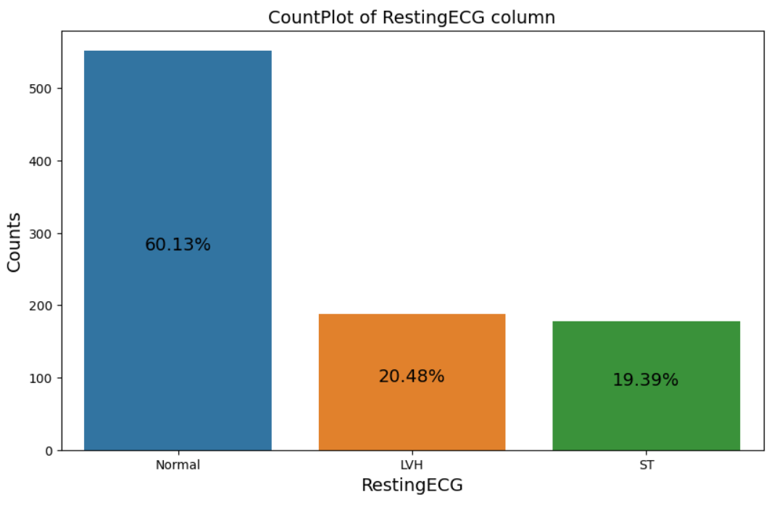
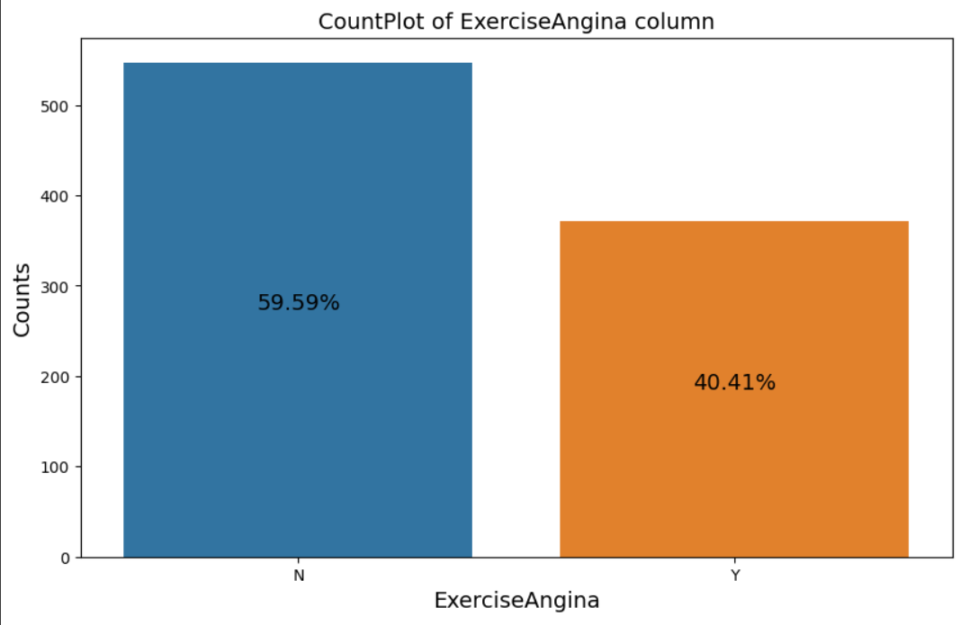
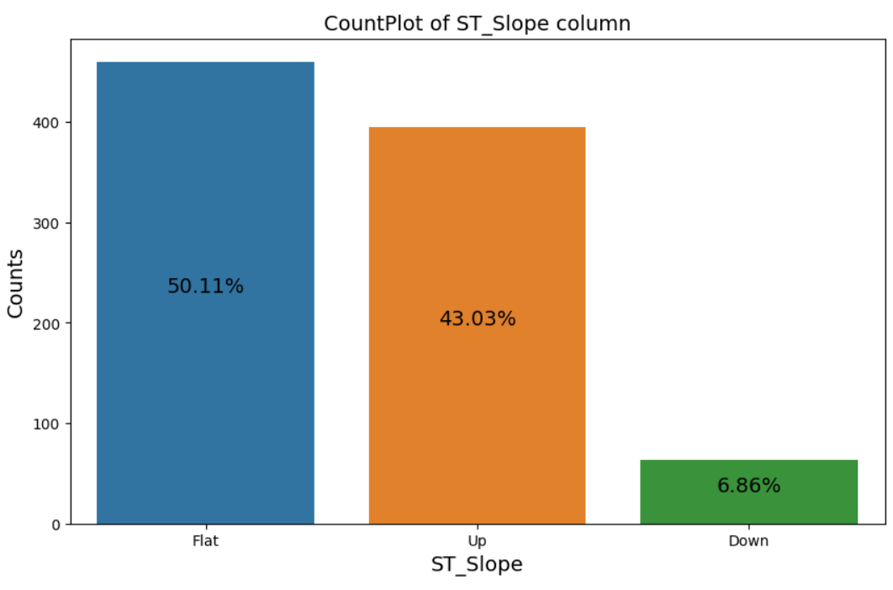
Categorical Features Exploration
FastingBS
ChestPainType
Sex
Resting ECG
ExerciseAngina
ST_Slope

Slide 8
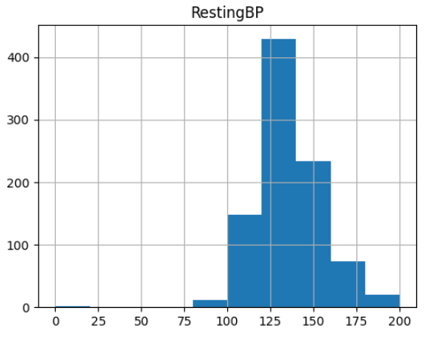
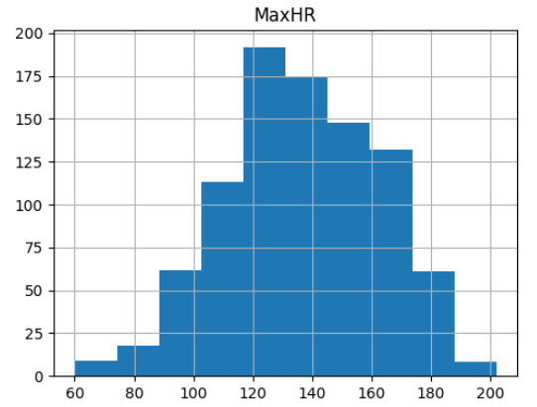
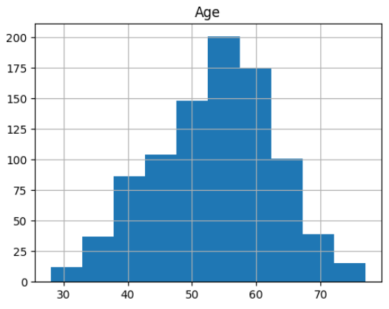
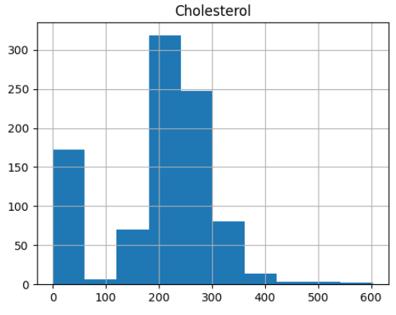
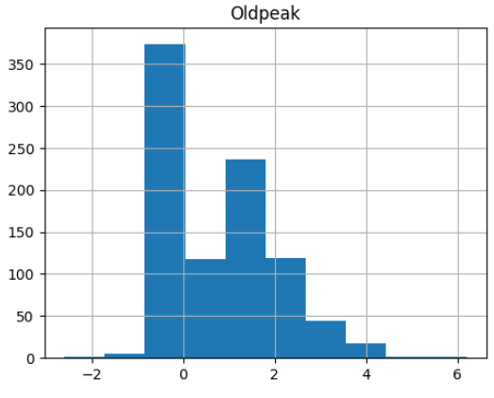
Numerical Features Exploration
RestingBP
MaxHR
Age
Cholestrol
Oldpeak

Slide 9
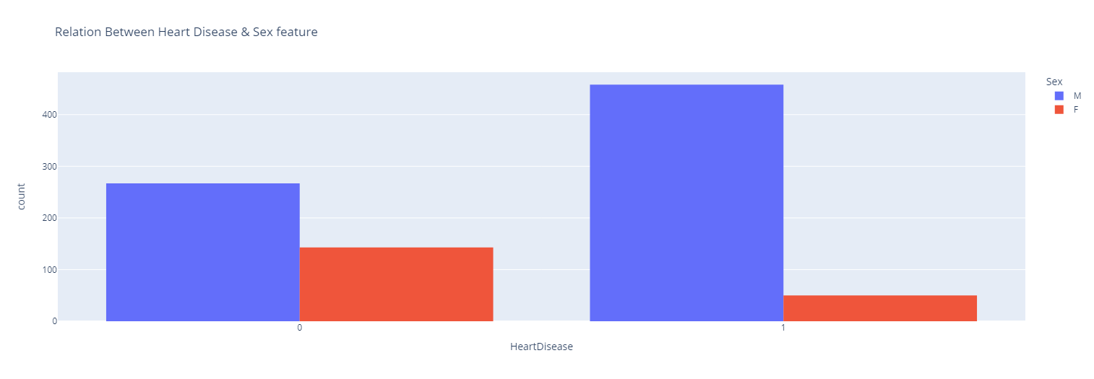
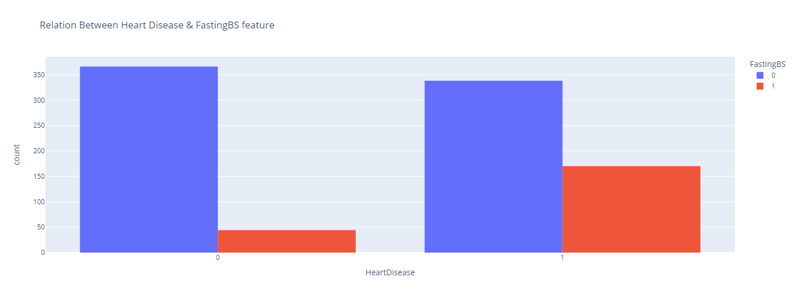
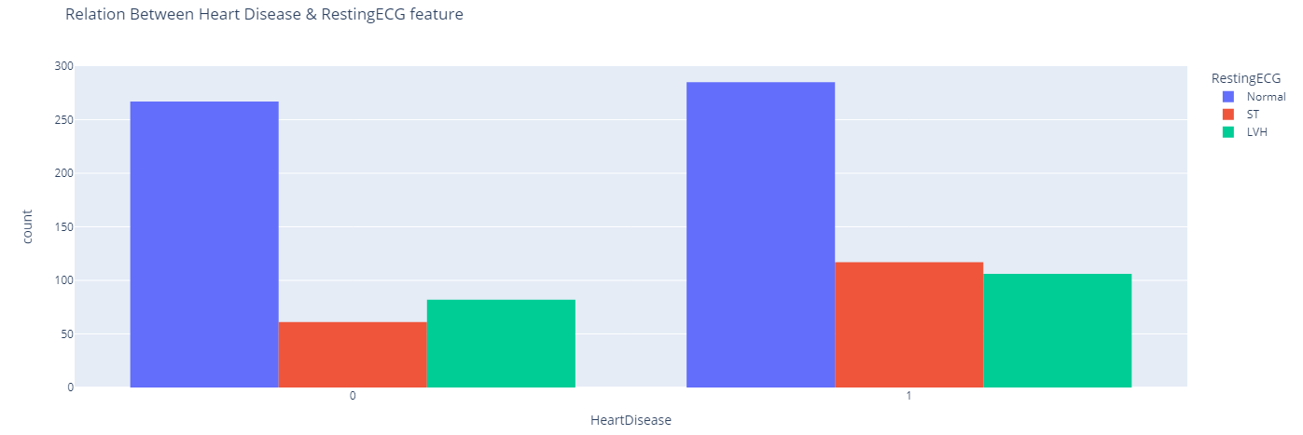
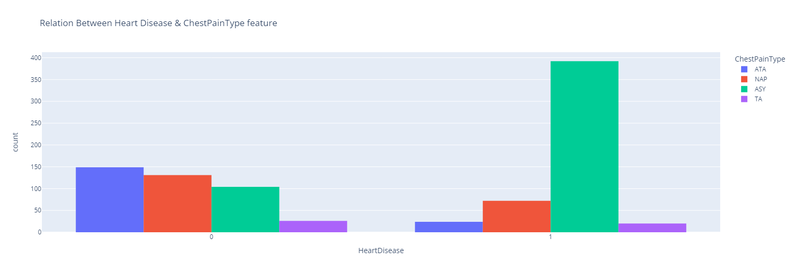
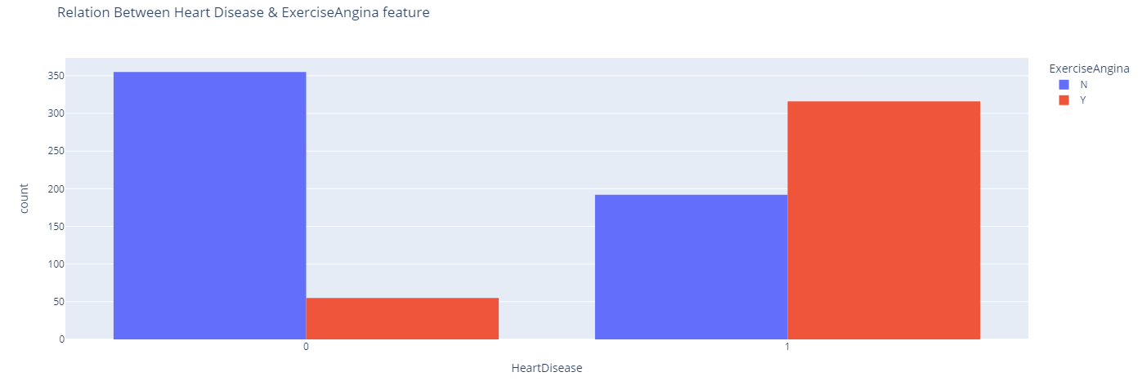
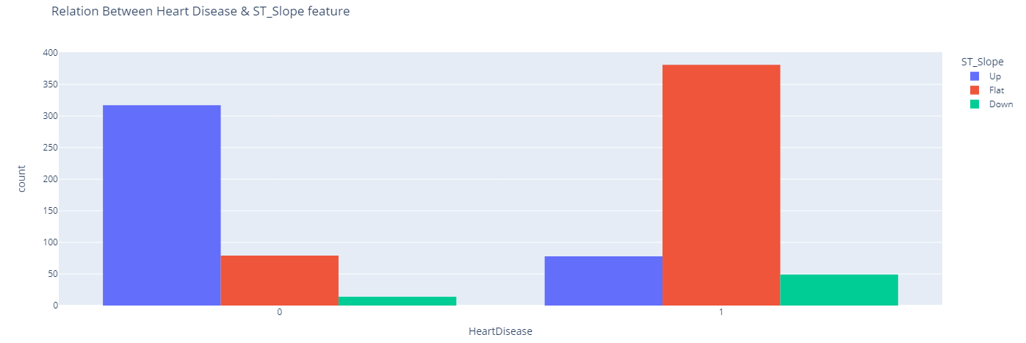
Relation Between Categorical Features and Heart Failure
Sex
FastingBS
Resting ECG
ChestPainType
ST_Slope
ExerciseAngina

Slide 10
Observations for Categorical Features:
Sex: "Male" is more likely to have heart disease than Female.
ChestPainType: People have type "ASY" are more likely to have heart disease than people have other Types, then "NAP".
FastingBS: people who have "BS < 120" sometimes have heart disease and others sometimes have not. and most people who have BS > 120 also have heart disease.
RestingECG: people who have the "Normal" type are more likely to have heart disease, then "ST", and finally "LVH".
ExerciseAngina: Most people have Angina "Yes" have heart disease.
ST_Slop: "Flat" slope displays a very high probability of being diagnosed with heart disease, then "Up", then "Down".

Slide 11
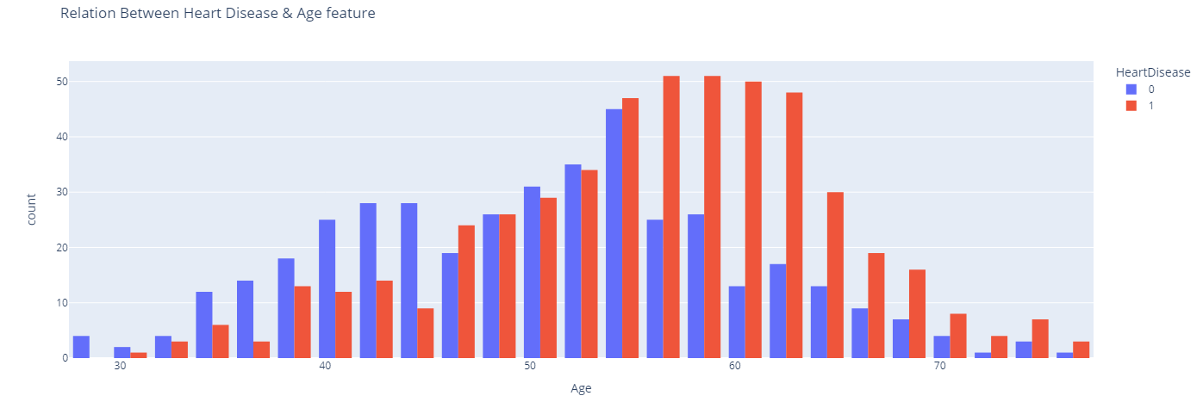
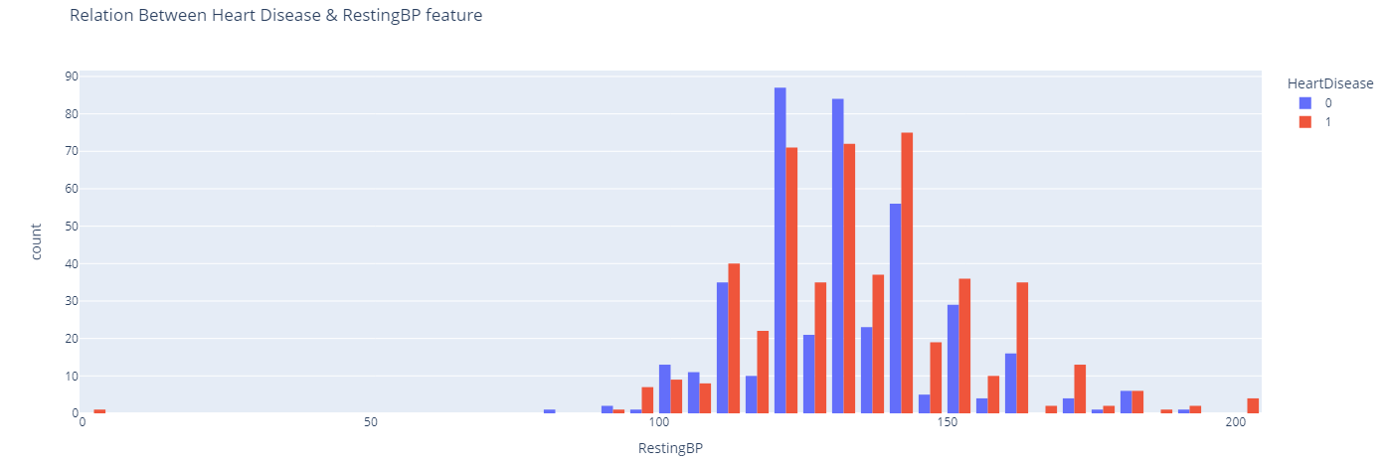
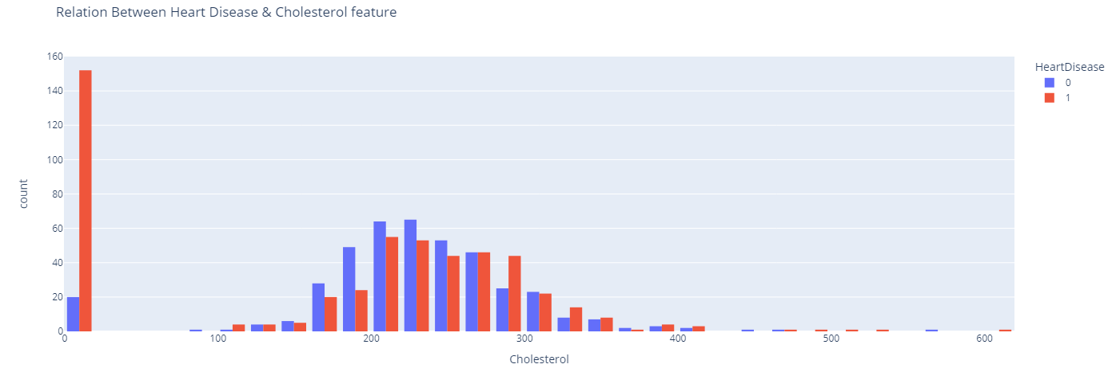
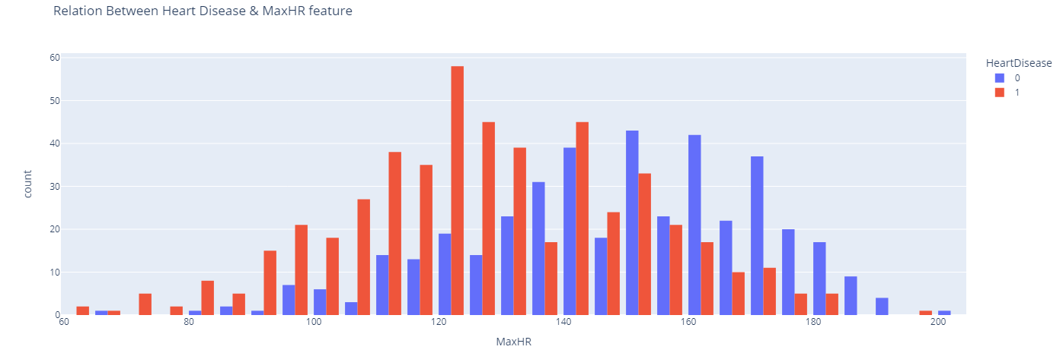
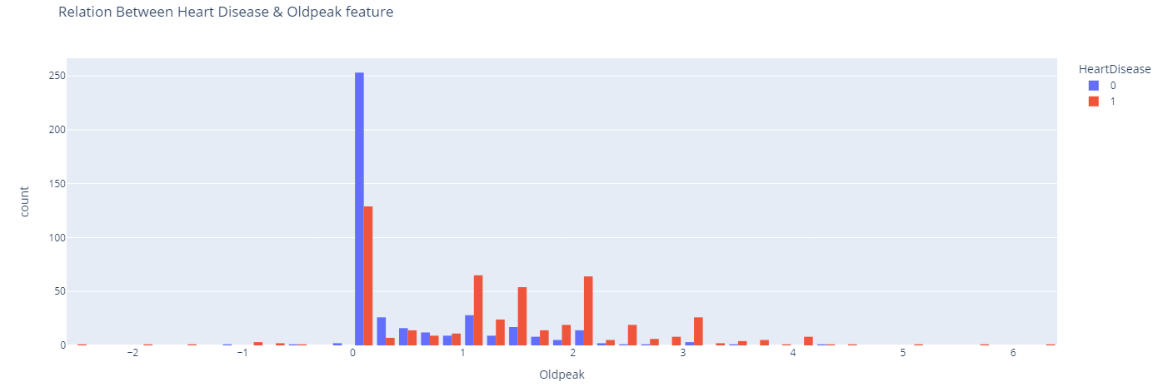
Relation Between Numerical Features and Heart Failure
Age
RestingBP
Cholestrol
MaxHR
Oldpeak

Slide 12
Observations for Numerical Features:
Age: people have "54+" are more likely to have heart disease.
RestingBP: Most values overlapping, but values in the range "135 <" have a high probability of being diagnosed with heart disease.
Cholesterol: Zero values affect results, and it does not make sense, so I will handle it in a preprocessing step, but values in the range "280 <" have a high probability of being diagnosed with heart disease.
MaxHR: people who have MaxHR in the range "90:149" have a high probability of being diagnosed with heart disease.
Oldpeak: Most values display Heart disease, but values in the range "1<" display a high probability of being diagnosed with heart disease.

Slide 13
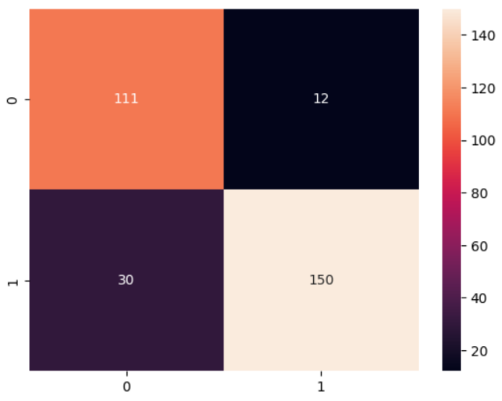
Conclusion:
I success to predict Heart Failure with an accuracy of 86% by using the LogisticRegression Algorithm which is the best accuracy depending on my experiment.
I used a lot of steps:
Business & Data Understanding.
Load & show Data.
Explore Data.
EDA and Extract Insights.
Data Preprocessing.
Handle zero rows.
Convert Categorical Features to Numerical.
Scaling Data.
split Data.
Apply Machine Learning algorithms to predict Heart Failure.

Slide 14
Recommendations:
Depending on observation from Chest Pain Type the "ASY" type is the most.
The patient who has this type does not feel any pain, which appears only in medical examinations, so I recommend that the patient make checkups frequently.
Depending on observation from Age, RestingBP, Cholesterol, and FastingBS columns.
For people aged 54+, I recommend They are trying to make pressure, sugar, and cholesterol not go beyond the normal limit.
Depending on observation from the MaxHR column.
people must take care that their Max Heart Rate that not go beyond 90.

Slide 15
Thank you
Naira Hassan
nairahassan2308@gmail.com

